Slide 1
Terremark Deep-Dive

Slide 2
What is Terremark vCloudExpress?
VMWare based public cloud
More of a traditional cloud datacenter
Offerings
Compute
Storage
Networking (Integrated firewall)
Hardware based load balancers
Console Access
VPN Access
API is an extension of vCloud API

Slide 3
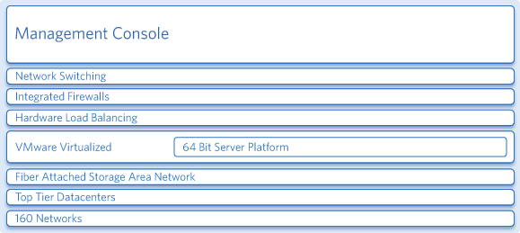
Terremark’s Offerings

Slide 4
Salient Points
Broad OS support
Ability to install own OS with ISOs on blank servers
Large choice of configurations
Choose number of virtual processors
RAM upto 16GB
Upto 15 virtual disks, each disk upto 512GB: Fibre channel storage
Enterprise grade firewall: Cisco networking
Server Cloning
Clustered Hypervisor: Failed virtual servers automatically restarted
Easy to forklift applications

Slide 5
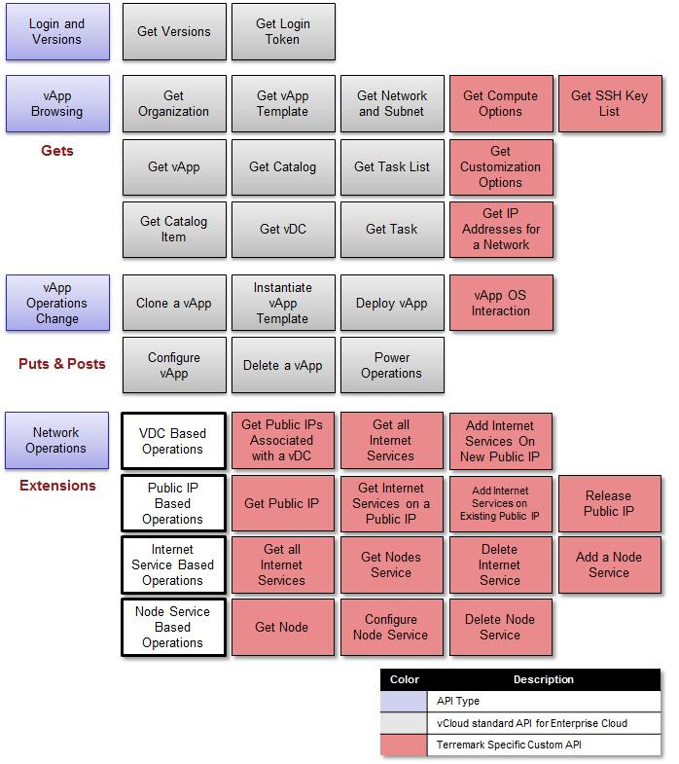
Terremark API Organization

Slide 6
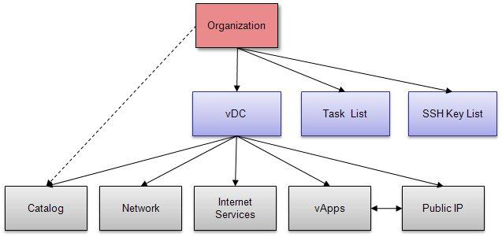
Terremark API Details
vDC = Environment
vApp is a virtual server or an operating environment.
Multiple vApps can be within a vDC
Network is a collection of private IPs that can be associated with vApps and internet services
Internet Services are associated with Public IPs

Slide 7
Example: Instantiate vApp Template
This call creates a new vApp based on a template
Request
POST https://{Terremark URI}/vdc/{vDC id}/action/instantiatevAppTemplate
Example:
POST https://services.vCloudexpress.terremark.com/api/v0.8a-ext1.6/vdc/1/action/instantiatevAppTemplate
Request Body
When you instantiate a vApp Template you are creating a new vApp. The minimum required configuration for the vApp, supplied during instantiation is:
vApp Name
Template URI
Virtual CPUs
Virtual Memory
Notes:
<InstantiateVAppTemplateParams name="MyAppServer5" xml:lang="en" xmlns="http://www.vmware.com/vCloud/v0.8" xmlns:xsi="http://www.w3.org/2001/XMLSchema-instance">
<VAppTemplate href="https://services.vCloudexpress.terremark.com/api/v0.8a-ext1.6/vAppTemplate/139" />
<-- Virtual memory --> <Item xmlns="http://schemas.dmtf.org/ovf/envelope/1"> <InstanceID xmlns="http://schemas.dmtf.org/wbem/wscim/1/cim-schema/2/CIM_ResourceAllocationSettingData">2</InstanceID> <ResourceType xmlns="http://schemas.dmtf.org/wbem/wscim/1/cim-schema/2/CIM_ResourceAllocationSettingData">4</ResourceType> <VirtualQuantity xmlns="http://schemas.dmtf.org/wbem/wscim/1/cim-schema/2/CIM_ResourceAllocationSettingData">1024</VirtualQuantity> </Item> </VirtualHardwareSection> <NetworkConfigSection> <NetworkConfig> <NetworkAssociation href="https://services.vCloudexpress.terremark.com/api/v0.8a-ext1.6/network/7" /> </NetworkConfig> </NetworkConfigSection> </InstantiationParams> </InstantiateVAppTemplateParams>
RESPONSE:
The response contains the ID of the new vApp.
HTTP/1.1 200 OK Content-Type: application/xml Content-Length: 424
<VApp href="https://services.vCloudexpress.terremark.com/api/v0.8a-ext1.6/vapp/4213" type="application/vnd.vmware.vCloud.vApp+xml" name="MyAppServer5" status="0" size="4" xmlns=http://www.vmware.com/vCloud/v0.8 xmlns:xsi="http://www.w3.org/2001/XMLSchema-instance" xmlns:xsd="http://www.w3.org/2001/XMLSchema">

Slide 8
vCloudExpress Demo
Notes:
<InstantiateVAppTemplateParams name="MyAppServer5" xml:lang="en" xmlns="http://www.vmware.com/vCloud/v0.8" xmlns:xsi="http://www.w3.org/2001/XMLSchema-instance">
<VAppTemplate href="https://services.vCloudexpress.terremark.com/api/v0.8a-ext1.6/vAppTemplate/139" />
<-- Virtual memory --> <Item xmlns="http://schemas.dmtf.org/ovf/envelope/1"> <InstanceID xmlns="http://schemas.dmtf.org/wbem/wscim/1/cim-schema/2/CIM_ResourceAllocationSettingData">2</InstanceID> <ResourceType xmlns="http://schemas.dmtf.org/wbem/wscim/1/cim-schema/2/CIM_ResourceAllocationSettingData">4</ResourceType> <VirtualQuantity xmlns="http://schemas.dmtf.org/wbem/wscim/1/cim-schema/2/CIM_ResourceAllocationSettingData">1024</VirtualQuantity> </Item> </VirtualHardwareSection> <NetworkConfigSection> <NetworkConfig> <NetworkAssociation href="https://services.vCloudexpress.terremark.com/api/v0.8a-ext1.6/network/7" /> </NetworkConfig> </NetworkConfigSection> </InstantiationParams> </InstantiateVAppTemplateParams>
RESPONSE:
The response contains the ID of the new vApp.
HTTP/1.1 200 OK Content-Type: application/xml Content-Length: 424
<VApp href="https://services.vCloudexpress.terremark.com/api/v0.8a-ext1.6/vapp/4213" type="application/vnd.vmware.vCloud.vApp+xml" name="MyAppServer5" status="0" size="4" xmlns=http://www.vmware.com/vCloud/v0.8 xmlns:xsi="http://www.w3.org/2001/XMLSchema-instance" xmlns:xsd="http://www.w3.org/2001/XMLSchema">

